Slide 1
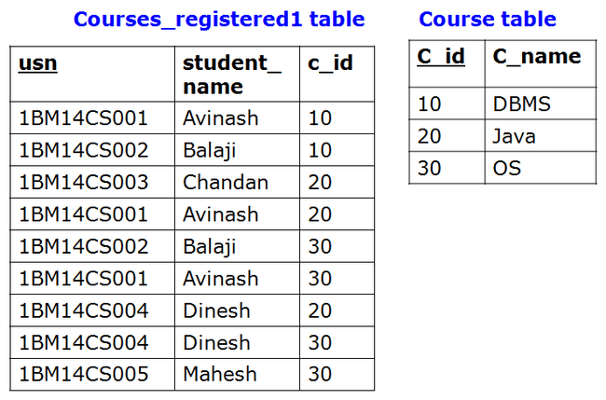
SQL HAVING Clause
Why we need Having clause ??
Say we want to find USNs of the students who have registered for atleast two courses
Monday, September 14, 2020
CSE, KL luniversity

Slide 2
SQL HAVING Clause
The HAVING clause was added to SQL because the WHERE keyword could not be used with aggregate functions.
SQL HAVING Syntax
SELECT column_name, aggregate_function(column_name)
FROM table_name
WHERE column_name operator value
GROUP BY column_name
HAVING aggregate_function(column_name) operator value
Monday, September 14, 2020
CSE, KL luniversity

Slide 3
SQL HAVING Clause
List USNs of the students who have registered for atleast
two courses
Monday, September 14, 2020
CSE, KL luniversity

Slide 4

SQL HAVING Clause
List USNs of the students who have registered for atleast
two courses
Monday, September 14, 2020
CSE, KL luniversity

Slide 5
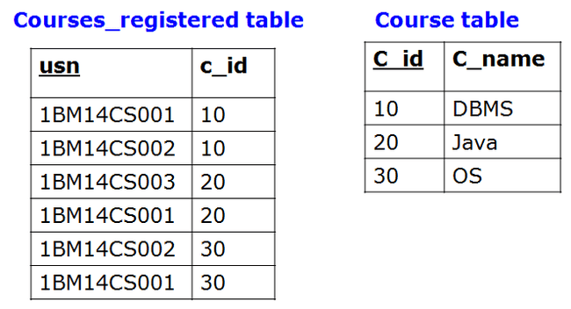
SQL HAVING Clause
What will be the out put of the following SQL query
Monday, September 14, 2020
CSE, KL luniversity

Slide 6

SQL HAVING Clause
What will be the out put of the following SQL query
Monday, September 14, 2020
CSE, KL luniversity

Slide 7
SQL HAVING Clause
List number of courses registered and Names of the student whose names end with ‘h’ and having registered for at least two courses
Monday, September 14, 2020
CSE, KL luniversity

Slide 8


SQL HAVING Clause
List number of courses registered and Names of the student whose names end with ‘h’ and having registered for at least two courses
Monday, September 14, 2020
CSE, KL luniversity

Slide 9


SQL HAVING Clause
What will be the out put of the
following SQL query
Monday, September 14, 2020
CSE, KL luniversity

Slide 10
Remember the following steps to a complete understanding of SQL:
FROM generates the data set
WHERE filters the generated data set
GROUP BY aggregates the filtered data set
HAVING filters the aggregated data set
SELECT transforms the filters aggregated data set
ORDER BY sorts the transformed data set
Monday, September 14, 2020
CSE, KL luniversity

Slide 11
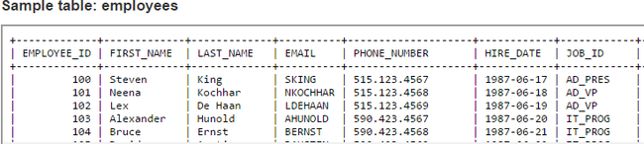
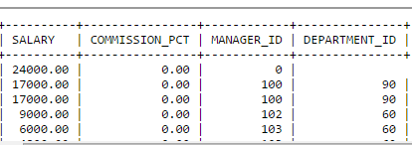
SQL practice Questions
Write a query to get the total salaries payable to employees.
90
Monday, September 14, 2020
CSE, KL luniversity

Slide 12
SQL practice Questions
Write a query to get the total salaries payable to employees.
SELECT SUM(salary) FROM employees;
90
Monday, September 14, 2020
CSE, KL luniversity

Slide 13
SQL practice Questions
Write a query to list the number of job ids available in the employees table.
90
Monday, September 14, 2020
CSE, KL luniversity

Slide 14
SQL practice Questions
Write a query to list the number of job ids available in the employees table.
SELECT COUNT(DISTINCT job_id)
FROM employees;
90
Monday, September 14, 2020
CSE, KL luniversity

Slide 15
SQL practice Questions
90
Write a query to get the maximum salary of an employee
working as a IT_PROG.
Monday, September 14, 2020
CSE, KL luniversity

Slide 16
SQL practice Questions
90
Write a query to get the maximum salary of an employee
working as a IT_PROG.
SELECT MAX(salary)
FROM employees
WHERE job_id = 'IT_PROG';
Monday, September 14, 2020
CSE, KL luniversity

Slide 17
SQL practice Questions
90
Write a query to get the department ID and the total salary
payable in each department.
Monday, September 14, 2020
CSE, KL luniversity

Slide 18
SQL practice Questions
90
Write a query to get the department ID and the total salary
payable in each department.
SELECT department_id, SUM(salary)
FROM employees
GROUP BY department_id;
Monday, September 14, 2020
CSE, KL luniversity

Slide 19
SQL practice Questions
90
Write a query to get the average salary for each job ID
excluding IT_PROG.
Monday, September 14, 2020
CSE, KL luniversity

Slide 20
SQL practice Questions
90
Write a query to get the average salary for each job ID
excluding IT_PROG.
SELECT job_id, AVG(salary)
FROM employees
WHERE job_id != 'IT_PROG'
GROUP BY job_id;
Monday, September 14, 2020
CSE, KL luniversity

Slide 21
SQL practice Questions
90
Write a query to get the average salary for all departments
employing more than 10 employees.
Monday, September 14, 2020
CSE, KL luniversity

Slide 22
SQL practice Questions
90
Write a query to get the average salary for all departments
employing more than 10 employees.
SELECT AVG(salary), COUNT(employee_id)
FROM employees
GROUP BY department_id
HAVING COUNT(employee_id) > 10;
Monday, September 14, 2020
CSE, KL luniversity

Slide 23
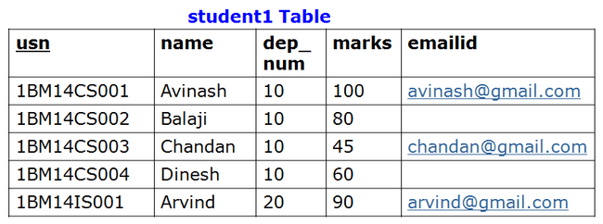
SQL DELETE Statement
The DELETE statement is used to delete rows in a table.
SQL DELETE Syntax
DELETE FROM table_name
WHERE some_column=some_value
delete from student1
where usn=‘1BM14IS001’;
Monday, September 14, 2020
CSE, KL luniversity

Slide 24
Topics Covered in Todays Class
Unit 1: More Complex SQL queries
Nested Queries, Tuples and Set/Mutiset Comparison
Monday, September 14, 2020
CSE, KL luniversity

Slide 25
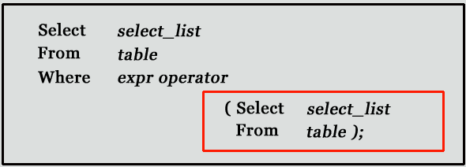
Subqueries or Nested Queries
A subquery is a SQL query nested inside a larger query.
SELECT colname1, colname2………. (SELECT ……….)
Note: Subqueries must be enclosed with in parenthesis
A subquery is usually added within the WHERE Clause of another SQL SELECT statement.
  We can use the comparison operators, such as >, <, or =. The comparison operator can also be a multiple-row operator, such as IN, ANY, SOME, or ALL.
A subquery can be treated as an inner query, which is a SQL query placed as a part of another query called as outer query.
The inner query executes first before its parent query so that the results of inner query can be passed to the outer query.
Outer Query
Inner Query
Monday, September 14, 2020
CSE, KL luniversity
Notes:
SELECT column-names
FROM table-name1
WHERE value IN (SELECT column-name
FROM table-name2
WHERE condition)

Slide 26
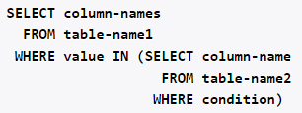
Subqueries or Nested Queries
A subquery is a SQL query nested inside a larger query.
SELECT colname1, colname2………. (SELECT ……….)
Note: Subqueries must be enclosed with in parenthesis
A subquery is usually added within the WHERE Clause of another SQL SELECT statement.
  We can use the comparison operators, such as >, <, or =. The comparison operator can also be a multiple-row operator, such as IN, ANY, SOME, or ALL.
A subquery can be treated as an inner query, which is a SQL query placed as a part of another query called as outer query.
The inner query executes first before its parent query so that the results of inner query can be passed to the outer query.
Outer Query
Inner Query
Monday, September 14, 2020
CSE, KL luniversity
Notes:
SELECT column-names
FROM table-name1
WHERE value IN (SELECT column-name
FROM table-name2
WHERE condition)

Slide 27
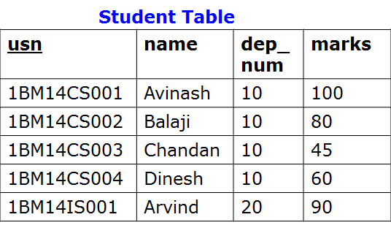
Subqueries
List names of the students whose marks score is greater than ‘Balaji’
Monday, September 14, 2020
CSE, KL luniversity

Slide 28
Subqueries
List names of the students whose marks score is greater than ‘Balaji’
Outer Query
Inner Query
Monday, September 14, 2020
CSE, KL luniversity

Slide 29
Subqueries
List names of the students whose marks score is greater than ‘Balaji’
Outer Query
80
Inner Query
Monday, September 14, 2020
CSE, KL luniversity

Slide 30

Subqueries
List names of the students whose marks score is greater than ‘Balaji’
Monday, September 14, 2020
CSE, KL luniversity

Slide 31
Subqueries
List name of the student whose marks score is second highest
Monday, September 14, 2020
CSE, KL luniversity

Slide 32

Subqueries
List name of the student whose marks score is second highest
Monday, September 14, 2020
CSE, KL luniversity

Slide 33
Subqueries : Using Comparisons
A subquery can be used before or after any of the comparison operators.
The subquery can return at most one value. The value can be the result of an arithmetic expression or a column function.
SQL then compares the value that results from the subquery with the value on the other side of the comparison operator. You can use the following comparison operators:
Operator | Description
= | Equal to
> | Greater than
>= | Greater than or equal to
< | Less than
<= | Less than or equal to
!= | Not equal to
Monday, September 14, 2020
CSE, KL luniversity

Slide 34
Activity To Do
movie_director(movie_title,pid) person(pid,name)
movie_title | pid
Guru | P1
Dasvathaaram | P2
Raavan | P1
pid | name
P1 | ManiRathnam
P2 | KamalHassan
Write Query to,
List down the movie titles directed by 'ManiRathnam'
Monday, September 14, 2020
CSE, KL luniversity
Notes:
movie(mid,title,year,rating,votes)

Slide 35

Activity To Do
movie_director(movie_title,pid) person(pid,name)
select movie_title
from movie_director
where pid=(select pid from person where name=‘ManiRatnam’);
movie_title | pid
Guru | P1
Dasvathaaram | P2
Raavan | P1
pid | name
P1 | ManiRathnam
P2 | KamalHassan
Write Query to,
List down the movie titles directed by 'ManiRathnam'
Monday, September 14, 2020
CSE, KL luniversity
Notes:
movie(mid,title,year,rating,votes)
http://www.w3resource.com/mysql/subqueries/index.php
Techtud correlated query
https://www.youtube.com/watch?v=gQCMp2K_yDI

Slide 36

Activity To Do
movie_director(movie_title,pid) person(pid,name)
movie_title | pid
Guru | P1
Dasvathaaram | P2
Raavan | P1
pid | name
P1 | ManiRathnam
P2 | KamalHassan
Write Query to,
List down the movie titles directed by 'ManiRathnam'
Monday, September 14, 2020
CSE, KL luniversity
Notes:
movie(mid,title,year,rating,votes)
http://www.w3resource.com/mysql/subqueries/index.php
Techtud correlated query
https://www.youtube.com/watch?v=gQCMp2K_yDI

Slide 37
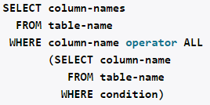
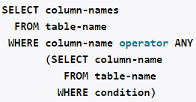
Subqueries with ALL, ANY, IN, or SOME
We can use a subquery after a comparison operator, followed by the keyword ALL, ANY, or SOME.
The ALL operator compares value to every value returned by the subquery. Therefore ALL operator (which must follow a comparison operator) returns TRUE if the comparison is TRUE for ALL of the values in the column that the subquery returns.
Syntax :
operand comparison_operator ALL (subquery)
Monday, September 14, 2020
CSE, KL luniversity

Slide 38
Subquery: ALL operator
> all means greater than every value, or greater than the maximum value.
For example, > all (1, 2, 3) means greater than 3.
Monday, September 14, 2020
CSE, KL luniversity
Notes:
https://oracle-base.com/articles/misc/all-any-some-comparison-conditions-in-sql
http://infocenter.sybase.com/help/index.jsp?topic=/com.sybase.infocenter.dc32300.1570/html/sqlug/sqlug191.htm

Slide 39
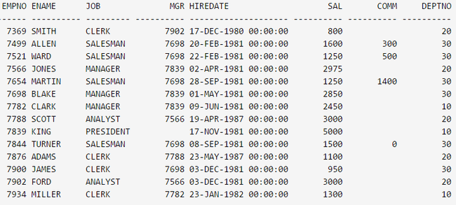
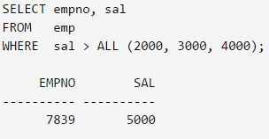
Subquery: ALL operator
> all means greater than every value, or greater than the maximum value.
Monday, September 14, 2020
CSE, KL luniversity
Notes:
https://oracle-base.com/articles/misc/all-any-some-comparison-conditions-in-sql
http://infocenter.sybase.com/help/index.jsp?topic=/com.sybase.infocenter.dc32300.1570/html/sqlug/sqlug191.htm

Slide 40
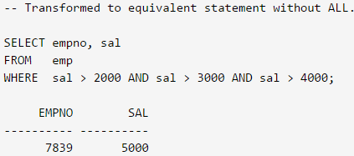
Subquery: ALL operator
> all means greater than every value, or greater than the maximum value.
Monday, September 14, 2020
CSE, KL luniversity
Notes:
https://oracle-base.com/articles/misc/all-any-some-comparison-conditions-in-sql
http://infocenter.sybase.com/help/index.jsp?topic=/com.sybase.infocenter.dc32300.1570/html/sqlug/sqlug191.htm

Slide 41
Activity To Do
List EMPNO and Salary of the employees whose salary is greater than the salary of all employees in the department 20
Monday, September 14, 2020
CSE, KL luniversity
Notes:
https://oracle-base.com/articles/misc/all-any-some-comparison-conditions-in-sql
http://infocenter.sybase.com/help/index.jsp?topic=/com.sybase.infocenter.dc32300.1570/html/sqlug/sqlug191.htm

Slide 42
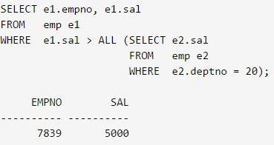
Activity To Do
List EMPNO and salary of the employees whose salary is greater than the salary of all employees in the department 20
Monday, September 14, 2020
CSE, KL luniversity
Notes:
https://oracle-base.com/articles/misc/all-any-some-comparison-conditions-in-sql
http://infocenter.sybase.com/help/index.jsp?topic=/com.sybase.infocenter.dc32300.1570/html/sqlug/sqlug191.htm

Slide 43
Subquery: ALL operator
> all means greater than all values
The > all operator means that, for a row to satisfy the condition in the outer query, the value in the column that introduces the subquery must be greater than each of the values returned by the subquery.
"x = ALL (...)": The value must match all the values in the list to evaluate to TRUE.
"x != ALL (...)": The value must not match any values in the list to evaluate to TRUE.
"x > ALL (...)": The value must be greater than the biggest value in the list to evaluate to TRUE.
"x < ALL (...)": The value must be smaller than the smallest value in the list to evaluate to TRUE.
"x >= ALL (...)": The value must be greater than or equal to the biggest value in the list to evaluate to TRUE.
"x <= ALL (...)": The value must be smaller than or equal to the smallest value in the list to evaluate to TRUE.
Monday, September 14, 2020
CSE, KL luniversity

Slide 44
Subquery: ANY operator
> any means greater than at least one value, or greater than the minimum value.
Therefore, > any (1, 2, 3) means greater than 1.
Monday, September 14, 2020
CSE, KL luniversity

Slide 45
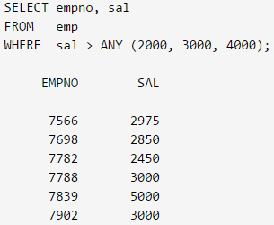
Subquery: ANY operator
> any means greater than at least one value, or greater than the minimum value.
Monday, September 14, 2020
CSE, KL luniversity

Slide 46
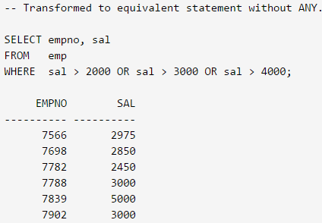
Subquery: ANY operator
> any means greater than at least one value, or greater than the minimum value.
Monday, September 14, 2020
CSE, KL luniversity

Slide 47
Activity To Do
List EMPNO and salary of the employees whose salary is greater than the salary of any employees in the department 10
Monday, September 14, 2020
CSE, KL luniversity
Notes:
https://oracle-base.com/articles/misc/all-any-some-comparison-conditions-in-sql
http://infocenter.sybase.com/help/index.jsp?topic=/com.sybase.infocenter.dc32300.1570/html/sqlug/sqlug191.htm

Slide 48
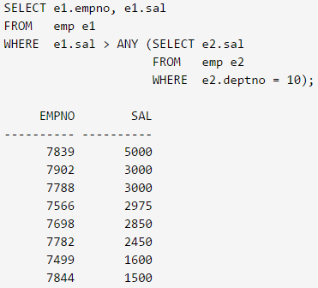
Activity To Do
List EMPNO and salary of the employees whose salary is greater than the salary of any employees in the department 10
Monday, September 14, 2020
CSE, KL luniversity
Notes:
https://oracle-base.com/articles/misc/all-any-some-comparison-conditions-in-sql
http://infocenter.sybase.com/help/index.jsp?topic=/com.sybase.infocenter.dc32300.1570/html/sqlug/sqlug191.htm

Slide 49
Subquery: ANY operator
> any means greater than at least one value
> any means that, for a row to satisfy the outer query, the value in the column that introduces the subquery must be greater than at least one of the values in the list returned by the subquery.
"x = ANY (...)": The value must match one or more values in the list to evaluate to TRUE.
"x != ANY (...)": The value must not match one or more values in the list to evaluate to TRUE.
"x > ANY (...)": The value must be greater than the smallest value in the list to evaluate to TRUE.
"x < ANY (...)": The value must be smaller than the biggest value in the list to evaluate to TRUE.
"x >= ANY (...)": The value must be greater than or equal to the smallest value in the list to evaluate to TRUE.
"x <= ANY (...)": The value must be smaller than or equal to the biggest value in the list to evaluate to TRUE.
Monday, September 14, 2020
CSE, KL luniversity

Slide 50
Subquery: SOME operator
The SOME and ANY comparison conditions do exactly the same thing and are completely interchangeable.
Monday, September 14, 2020
CSE, KL luniversity

Slide 51

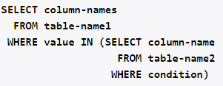
Subquery: IN Operator
Syntax
The number of values in the parenthesis can be
one or more, with each values separated by comma.
Values can be numerical or characters. If there is
only one value inside the parenthesis, this
command is equivalent to,
Monday, September 14, 2020
CSE, KL luniversity

Slide 52
Subquery: IN Operator
Syntax
The number of values in the parenthesis can be
one or more, with each values separated by comma.
Values can be numerical or characters. If there is
only one value inside the parenthesis, this
command is equivalent to,
Monday, September 14, 2020
CSE, KL luniversity

Slide 53
Subquery: IN Operator
Find the names of the publishers who have published CSE books:
publisher
titles
pid | pub_name
1 | Pearson
2 | Tata
3 | ABP
4 | GitaPress
pid | type
1 | CSE
2 | ISE
3 | CSE
4 | EC
Monday, September 14, 2020
CSE, KL luniversity

Slide 54
Subquery: IN Operator
Find the names of the publishers who have published CSE books:
publisher
titles
pid | pub_name
1 | Pearson
2 | Tata
3 | ABP
4 | GitaPress
pid | type
1 | CSE
2 | ISE
3 | CSE
4 | EC
select pub_name
from publisher
where pid in (select pid
from titles
where type = ‘CSE’)
pub_name
------------
Pearson
ABP
Monday, September 14, 2020
CSE, KL luniversity

Slide 55
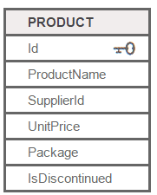
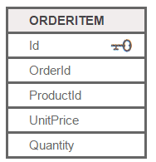
Activity To Do
List products with order quantities greater than 100.
Monday, September 14, 2020
CSE, KL luniversity
Notes:
https://oracle-base.com/articles/misc/all-any-some-comparison-conditions-in-sql
http://infocenter.sybase.com/help/index.jsp?topic=/com.sybase.infocenter.dc32300.1570/html/sqlug/sqlug191.htm

Slide 56
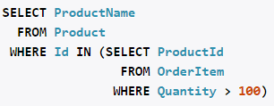
Activity To Do
List products with order quantities greater than 100.
Monday, September 14, 2020
CSE, KL luniversity
Notes:
https://oracle-base.com/articles/misc/all-any-some-comparison-conditions-in-sql
http://infocenter.sybase.com/help/index.jsp?topic=/com.sybase.infocenter.dc32300.1570/html/sqlug/sqlug191.htm
http://www.1keydata.com/sql/sql-select-unique.html

Slide 57
SQL JOIN statement
The SQL Joins clause is used to combine records from two or more tables.
A JOIN is a means for combining fields from two tables by using values common to each.
Monday, September 14, 2020
CSE, KL luniversity

Slide 58
Types of JOIN operator
Cartesian product or Cross Join
Inner Join
Outer Join
  Left-outer Join or Left Join
  Right-outer Join or Right Join
Full Join
Self Join
Monday, September 14, 2020
CSE, KL luniversity

Slide 59
CARTESIAN JOIN or CROSS JOIN
The CARTESIAN JOIN or CROSS JOIN returns the Cartesian product of the sets of records from the two or more joined tables.
Syntax of CARTESIAN JOIN or CROSS JOIN is as follows:
SELECT table1.column1, table2.column2...
FROM table1, table2 ;
Monday, September 14, 2020
CSE, KL luniversity
Notes:
http://www.tutorialspoint.com/sql/sql-inner-joins.htm
BOOK
http://www.w3resource.com/slides/mysql-joins-slides-presentation.php
http://www.w3resource.com/sql/joins/sql-joins.php

Slide 60


CARTESIAN JOIN or CROSS JOIN
The CARTESIAN JOIN or CROSS JOIN returns the Cartesian product of the sets of records from the two or more joined tables.
Syntax of CARTESIAN JOIN or CROSS JOIN is as follows:
SELECT table1.column1, table2.column2...
FROM table1, table2 ;
Query
table1
table2
ID | M
1 | a
2 | b
4 | c
ID | N
2 | p
3 | q
5 | r
OUTPUT
Monday, September 14, 2020
CSE, KL luniversity
Notes:
http://www.tutorialspoint.com/sql/sql-inner-joins.htm
BOOK
http://www.w3resource.com/slides/mysql-joins-slides-presentation.php
http://www.w3resource.com/sql/joins/sql-joins.php

Slide 61
General Syntax of JOIN types: Inner, Left Outer, Right Outer and Full Join
In order to perform a JOIN query, the required information we need are:
a) The name of the tables
b) Name of the columns of two or more tables, based on which a condition will perform.
SYNTAX
SELECT ColumNames……..
FROM table1 join_type table2
ON join_condition;
Monday, September 14, 2020
CSE, KL luniversity
Notes:
SELECT whatever FROM tablea AS a INNER JOIN tableb AS b ON b.b = a.a INNER JOIN tablec AS c ON c.c = b.b1 INNER JOIN tabled AS d ON d.d = c.c1

Slide 62
General Syntax of JOIN operation
In order to perform a JOIN query, the required information we need are:
a) The name of the tables
b) Name of the columns of two or more tables, based on which a condition will perform.
SYNTAX
SELECT ColumNames……..
FROM table1 join_type table2
ON join_condition;
First table or
Left table
Second table or
Right table
Monday, September 14, 2020
CSE, KL luniversity

Slide 63
Inner Join
Inner Join or Equi Join returns rows when there is a match in both tables.
The INNER JOIN creates a new result table by combining column values of two tables (table1 and table2) based upon the join-predicate. The query compares each row of table1 with each row of table2 to find all pairs of rows which satisfy the join-predicate. When the join-predicate is satisfied, column values for each matched pair of rows of A and B are combined into a result row.
Syntax of INNER JOIN:
SELECT table1.column1, table2.column2...
FROM table1 INNER JOIN table2
ON table1.common_field = table2.common_field;
Monday, September 14, 2020
CSE, KL luniversity

Slide 64

Inner Join
SELECT table1.column1, table2.column2...
FROM table1 INNER JOIN table2
ON table1.common_field = table2.common_field;
table1
table2
ID | M
1 | a
2 | b
4 | c
ID | N
2 | p
3 | q
5 | r
ID | M | ID | N
2 | b | 2 | p
Monday, September 14, 2020
CSE, KL luniversity

Slide 65

Inner Join
SELECT table1.column1, table2.column2...
FROM table1 INNER JOIN table2
ON table1.common_field = table2.common_field;
table1
table2
ID | M
1 | a
2 | b
4 | c
ID | N
2 | p
3 | q
5 | r
ID | M | ID | N
2 | b | 2 | p
Monday, September 14, 2020
CSE, KL luniversity

Slide 66
Inner Join: More than two tables
SELECT table1.column1, table2.column2,table3.colum3…....
FROM table1 INNER JOIN table2
ON table1.common_field = table2.common_field
INNER JOIN table3 ON table2.common_field = table3.common_field;
table1
table2
ID | M
1 | a
2 | b
4 | c
ID | N
2 | p
3 | q
5 | r
table3
ID | M | ID | N | ID | S
2 | b | 2 | p | 2 | x
ID | S
2 | x
6 | y
7 | z
Monday, September 14, 2020
CSE, KL luniversity

Slide 67
Left Outer Join
Left-Outer Join returns all rows from the left table, even if there are no matches in the right table.
This means that if the ON clause matches 0 (zero) records in right table, the join will still return a row in the result, but with NULL in each column from right table.
This means that a left join returns all the values from the left table, plus matched values from the right table or NULL in case of no matching join predicate.
Syntax of Left Outer Join or left join
SELECT table1.column1, table2.column2...
FROM table1 LEFT OUTER JOIN table2
ON table1.common_field = table2.common_field;
Monday, September 14, 2020
CSE, KL luniversity

Slide 68

Left Outer Join
SELECT table1.column1, table2.column2...
FROM table1 LEFT OUTER JOIN table2
ON table1.common_field = table2.common_field;
table1
table2
ID | M
1 | a
2 | b
4 | c
ID | N
2 | p
3 | q
5 | r
ID | M | ID | N
2 | b | 2 | P
1 | a
4 | c
Monday, September 14, 2020
CSE, KL luniversity

Slide 69
Right Outer Join
RIGHT JOIN or RIGHT OUTER JOIN returns all rows from the right table, even if there are no matches in the left table.
This means that if the ON clause matches 0 (zero) records in left table, the join will still return a row in the result, but with NULL in each column from left table.
This means that a right join returns all the values from the right table, plus matched values from the left table or NULL in case of no matching join predicate.
Syntax of Right Outer Join or Right join
SELECT table1.column1, table2.column2...
FROM table1 RIGHT OUTER JOIN table2
ON table1.common_field = table2.common_field;
Monday, September 14, 2020
CSE, KL luniversity

Slide 70

Right Outer Join
SELECT table1.column1, table2.column2...
FROM table1 RIGHT OUTER JOIN table2
ON table1.common_field = table2.common_field;
table1
table2
ID | M
1 | a
2 | b
4 | c
ID | N
2 | p
3 | q
5 | r
ID | M | ID | N
2 | b | 2 | P
 |  | 3 | q
 |  | 5 | r
Monday, September 14, 2020
CSE, KL luniversity

Slide 71
Full Join
FULL JOIN combines the results of both left and right outer joins.
The joined table will contain all records from both tables, and fill in NULLs for missing matches on either side.
Syntax of Full join
SELECT table1.column1, table2.column2...
FROM table1 FULL JOIN table2
ON table1.common_field = table2.common_field;
Monday, September 14, 2020
CSE, KL luniversity

Slide 72

Full Join
SELECT table1.column1, table2.column2...
FROM table1 FULL JOIN table2
ON table1.common_field = table2.common_field;
table1
table2
ID | M
1 | a
2 | b
4 | c
ID | N
2 | p
3 | q
5 | r
ID | M | ID | N
2 | b | 2 | p
 |  | 3 | q
 |  | 5 | r
1 | a
4 | c
Monday, September 14, 2020
CSE, KL luniversity

Slide 73
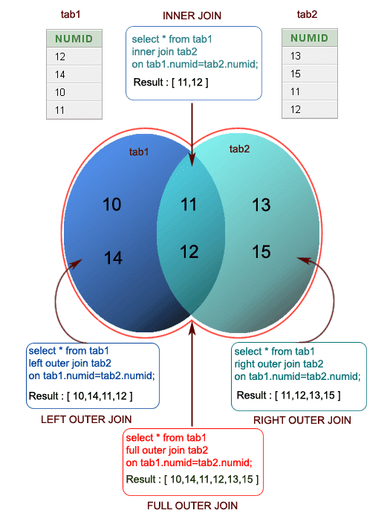
Types of
Joins
Monday, September 14, 2020
CSE, KL luniversity

Slide 74
Self Join
SELF JOIN is used to join a table to itself as if the table were two tables, temporarily renaming at least one table in the SQL statement.
Syntax:
SELECT a.column1, b.column2...
FROM table1 a , table1 b
WHERE table1.common_field = table1.common_field;
Monday, September 14, 2020
CSE, KL luniversity
Notes:
SELECT a.column_name, b.column_name... FROM table1 a, table1 b WHERE a.common_field = b.common_field;

Slide 75
Self Join
Write SQL query
To list all employee names along with their manager’s name
Employee table
EMP_ID | EMP_Name | Manager_ID
101 | Avinash | 103
102 | Balaji | 101
103 | Chandan
104 | Dinesh | 101
OUTPUT
EMP_Name | Manager_ID
Avinash | Chandan
Balaji | Avinash
Dinesh | Avinash
Monday, September 14, 2020
CSE, KL luniversity

Slide 76
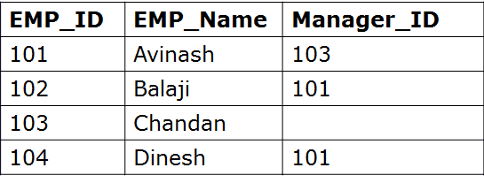
Logic of Self Join
Employee E
Employee M
Compare
E.Manager_ID= M.EMP_ID
If equal list
E.EMP_Name, M.EMP_Name
Monday, September 14, 2020
CSE, KL luniversity

Slide 77
Logic of Self Join
Employee E
Employee M
Compare
E.Manager_ID= M.EMP_ID
If equal list
E.EMP_Name, M.EMP_Name
Monday, September 14, 2020
CSE, KL luniversity

Slide 78
Logic of Self Join
Employee E
Employee M
Compare
E.Manager_ID= M.EMP_ID
Output
--------------------
Aninash, Chandan
If equal list
E.EMP_Name, M.EMP_Name
Monday, September 14, 2020
CSE, KL luniversity

Slide 79

Self Join
Write SQL query
To list all employee names along with their manager’s name
Employee table
EMP_Name | Manager_ID
Avinash | Chandan
Balaji | Avinash
Dinesh | Avinash
Monday, September 14, 2020
CSE, KL luniversity

Slide 80
Practice SQL Query
List details of customer who have purchased some items
Customer
Cust_ID | Cust_Name
Customer Purchase
Cust_ID | ItemID | QtyPurchased | TotalPrice
Monday, September 14, 2020
CSE, KL luniversity

Slide 81
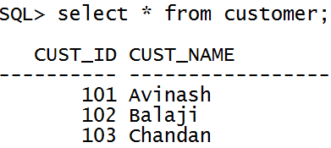
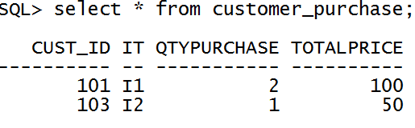

Practice SQL Query
List details of customer who have purchased some items
OUTPUT should be
Monday, September 14, 2020
CSE, KL luniversity

Slide 82

Practice SQL Query
List details of customer who have purchased some items
Monday, September 14, 2020
CSE, KL luniversity

Slide 83
Practice SQL Query
List details of customer who have purchased some items
Monday, September 14, 2020
CSE, KL luniversity

Slide 84
Practice SQL Query
List all customer details and loan details if they have availed loans or yet to avail loan
Customer_Account_Details
Cust_ID | Cust_Name
Customer_Loans
Loan_ID | Cust_ID | Amount_in_Rupees
Monday, September 14, 2020
CSE, KL luniversity

Slide 85
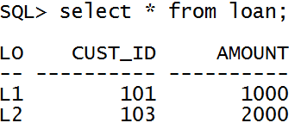
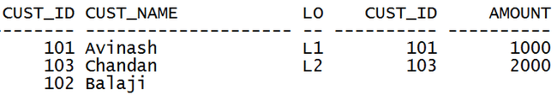
Practice SQL Query
List all customer details and loan details if they have availed loans or yet to avail loan
Monday, September 14, 2020
CSE, KL luniversity

Slide 86

Practice SQL Query
List all customer details and loan details if they have availed loans or yet to avail loan
Monday, September 14, 2020
CSE, KL luniversity

Slide 87
Practice SQL Query
Display details of Supplier who has been ordered to supply more than one item
Supplier
Suplier_ID | Suplier_Name
Item Order
Item_ID | Item_name | Supplier_ID
Monday, September 14, 2020
CSE, KL luniversity

Slide 88
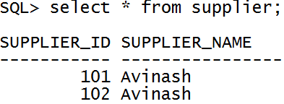
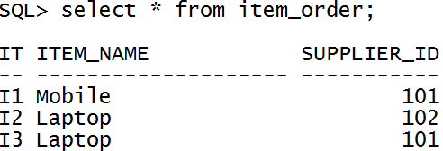

Practice SQL Query
Display details of Supplier who has been ordered to supply more than one item
OUTPUT
Monday, September 14, 2020
CSE, KL luniversity

Slide 89
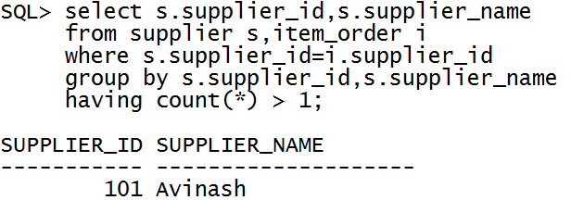
Practice SQL Query
Display details of Supplier who has been ordered to supply more than one item
Monday, September 14, 2020
CSE, KL luniversity

Slide 90
Practice SQL Query
Display details of Supplier who has been ordered to supply more than one item
Supplier
Suplier_ID | Suplier_Name
Item Order
Item_ID | Item_name | Supplier_ID
Select s.Supplier_ID,s.Supplier_Name
From Supplier s,ItemOrder i
Where s.Supplier_ID=i.SupplierID
Group By s.Supplier_ID,s.Supplier_Name
Having Count(*) > 1
Monday, September 14, 2020
CSE, KL luniversity

Slide 91
NULL Values
It is possible for tuples to have a null value, denoted by null, for some of their attributes
null signifies an unknown value or that a value does not exist.
The predicate is null can be used to check for null values.
  Example: Find all loan number which appear in the loan relation with null values for amount.
select loan_number
from loan
where amount is null
The result of any arithmetic expression involving null is null
  Example: 5 + null returns null
However, aggregate functions simply ignore nulls
Monday, September 14, 2020
CSE, KL luniversity

Slide 92
Null value interpretation
Unknown value: A particular person has date of birth but it is not known, so it is represented by NULL in the database.
Unavailable or withheld value: A person has a home phone but does not want it to be listed, so it is withheld and represented as NULL in the database.
Not applicable attribute: An attribute LastCollegeDegree would be NULL for a person who has no college degree because it does not apply to that person.
Monday, September 14, 2020
CSE, KL luniversity

Slide 93
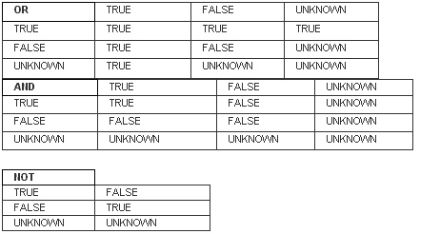
Null Values and Three Valued Logic
TRUE, FALSE and UNKNOWN
A comparison between known values gives you a result of TRUE or FALSE. This is Boolean logic.
When you do a comparison with a NULL, you cannot get a Boolean (i.e. TRUE or FALSE) result. This is where the logical value UNKNOWN was invented.
Logical Connectives in Three-valued logic
Monday, September 14, 2020
CSE, KL luniversity

Slide 94
Topics Covered in Todays Class
Unit 1:
Views in SQL
Specifying Constraints as Assertions and Triggers
Monday, September 14, 2020
CSE, KL luniversity

Slide 95
Views in SQL
A view is a kind of “Virtual Table”
A view is customized representation of data from one or more tables. The tables that the view is referencing are know as base tables.
A view is considered as a stored query or a virtual table.
Why we need Views ?
Views, which are kind of virtual tables, allow users to do the following:
  Structure data in a way that users or classes of users find natural or intuitive.
  Restrict access to the data such that a user can see and (sometimes) modify exactly what they need and no more.
  Summarize data from various tables which can be used to generate reports.
Monday, September 14, 2020
CSE, KL luniversity

Slide 96
Creating Views
Database views are created using the CREATE VIEW statement. Views can be created from a single table, multiple tables, or another view.
To create a view, a user must have the appropriate system privilege according to the specific implementation.
The basic CREATE VIEW syntax is as follows:
CREATE VIEW view_name
AS SELECT column1, column2.....
FROM table_name
WHERE [condition];
Monday, September 14, 2020
CSE, KL luniversity

Slide 97
Creating Views
Example
faculty(F_ID, F_name, Dnum, Email_ID, Salary)
department(Dname,Dnumber)
VIRTUAL
Table
dep_info(Dept_name, Num_of_Emps, Total_Salary)
Monday, September 14, 2020
CSE, KL luniversity

Slide 98
Creating Views
Example
faculty(F_ID, F_name, Dnum, Email_ID, Salary)
department(Dname,Dnumber)
VIRTUAL
Table
dep_info(Dept_name, Num_of_Emps, Total_Salary)
CREATE VIEW dep_info(Dept_name,Num_of_Emps,Total_Salary)
AS Select d.Dname,count(*),sum(salary)
From department d, faculty f
Where d.Dnumber=f.Dnum
Group By d.Dname;
Monday, September 14, 2020
CSE, KL luniversity

Slide 99
Updating View
faculty(F_ID, F_name, Dnum, Email_ID, Salary)
VIRTUAL
Table
cs_faculty_view(F_ID, F_name, Dnum, Email_ID)
Monday, September 14, 2020
CSE, KL luniversity

Slide 100
Updating View
faculty(F_ID, F_name, Dnum, Email_ID, Salary)
VIRTUAL
Table
cs_faculty_view(F_ID, F_name, Dnum, Email_ID)
CREATE VIEW cs_faculty_view(F_ID, F_name, Dnum, Email_ID)
AS Select *
From faculty
Where Dnum=10;
Monday, September 14, 2020
CSE, KL luniversity

Slide 101
Updating View
Update cs_faculty_view
Set Email_ID=‘balaji@gmail.com’
Where Emp_name=‘Balaji’;
faculty(F_ID, F_name, Dnum, Email_ID, Salary)
VIRTUAL
Table
cs_faculty_view(F_ID, F_name, Dnum, Email_ID)
CREATE VIEW cs_faculty_view(F_ID, F_name, Dnum, Email_ID)
AS Select *
From faculty
Where Dnum=10;
Monday, September 14, 2020
CSE, KL luniversity

Slide 102
Updating a View
A view can be updated under certain conditions:
The SELECT clause may not contain the keyword DISTINCT.
The SELECT clause may not contain aggregate functions.
The SELECT clause may not contain set functions.
The SELECT clause may not contain set operators.
The SELECT clause may not contain an ORDER BY clause.
The FROM clause may not contain multiple tables.
The WHERE clause may not contain subqueries.
The query may not contain GROUP BY or HAVING.
Calculated columns may not be updated.
All NOT NULL columns from the base table must be included in the view in order for the INSERT query to function.
So if a view satisfies all the above-mentioned rules then you can update a view.
Note: Similarly
Rows of data can be inserted into a view.
Rows of data can be deleted from a view.
Monday, September 14, 2020
CSE, KL luniversity

Slide 103
Dropping Views:
Syntax
DROP VIEW view_name;
Example: drop view cs_faculty_view;
Monday, September 14, 2020
CSE, KL luniversity

Slide 104
Advantages and Disadvantages of views
Advantages of views
Security: Each user can be given permission to access the database only through a small set of views that contain the specific data the user is authorized to see, thus restricting the user's access to stored data
Query Simplicity: A view can draw data from several different tables and present it as a single table, turning multi-table queries into single-table queries against the view.
Structural simplicity: Views can give a user a "personalized" view of the database structure, presenting the database as a set of virtual tables that make sense for that user.
Consistency: A view can present a consistent, unchanged image of the structure of the database, even if the underlying source tables are split, restructured, or renamed.
Data Integrity: If data is accessed and entered through a view, the DBMS can automatically check the data to ensure that it meets the specified integrity constraints.
Logical data independence: View can make the application and database tables to a certain extent independent. If there is no view, the application must be based on a table. With the view, the program can be established in view of above, to view the program with a database table to be separated.
Disadvantages of views
Performance: Views create the appearance of a table, but the DBMS must still translate queries against the view into queries against the underlying source tables. If the view is defined by a complex, multi-table query then simple queries on the views may take considerable time.
Update restrictions: When a user tries to update rows of a view, the DBMS must translate the request into an update on rows of the underlying base tables. This is possible for simple views, but more complex views are often restricted to read-only.
Monday, September 14, 2020
CSE, KL luniversity

